Slide 1

Windows 7 Secrets
Paul Thurrott
Technology Analyst, Penton Media

Slide 2

Topics
Where we’re at from an industry perspective
Windows 7 – the impact on end users
Windows 7 – the impact on businesses
“Windows 7 Secrets” – About the book, and why I must hate myself

Slide 3
Optional topics
Office 2010 and the Office Web Applications
Microsoft’s cloud computing strategy

Slide 4
Where we’re at

Slide 5
2006-2009
Windows Vista didn’t exactly get a positive reception.
That said, it delivered on Microsoft’s promise to update the foundation of Windows to something more modern.
That foundation is used in Windows 7.

Slide 6
Windows 7
Windows 7 is all about delivering on the failures of Vista, real or imagined.
Real: Better performance, simpler and more efficient UI, more cohesiveness, etc.
Perception: Microsoft is finally fighting back with “I’m a PC” and other ads.

Slide 7
Windows 7 for end users
(the fun stuff)

Slide 8
“Windows Vista done right”
We’ve all heard this.
Ironic? People universally embrace Windows 7. Which is really just Windows Vista R2.
Low-level improvements: Smaller memory footprint, better performance, 100s of tiny usability tweaks.
The whole is greater than the parts.

Slide 9
Picking the right version
Virtually any home user: Windows 7 Home Premium.
Managed small businesses: Windows 7 Professional.
  Adds domain support, network-based backup, EFS, Remote Desktop host.
Enterprises: Windows 7 Enterprise.
  The full meal deal: BitLocker, BitLocker-To-Go

Slide 10
Setup
Setup has been simplified.
Clean install in 15-20 minutes.
Upgrade: Averages a couple of hours.
(Or, as IDG News reported, “Microsoft: Windows 7 upgrades to take 20 hours” Sigh.)
Windows XP users: No upgrade for you.
Don’t forget the Upgrade Advisor.

Slide 11
User experience
Biggest end user changes are in the UI...
  Personalization with Aero Themes and slideshows.
  Major changes to the Taskbar – Pinning, Jump Lists, Live Previews, and more.
  Notification area clean-up.
  Libraries and Windows Explorer.
  Windows Aero desktop effects: Aero Peek, Aero Snaps, Aero Shake.

Slide 12
User experience
Bundled apps
  Calculator
  Paint
  WordPad
  Sticky Notes, etc.
Missing apps
  Windows Live Essentials fills the gaps
You can also remove more apps than in Vista.

Slide 13
User experience
Windows Touch
  Multi-touch now a full-fledged interface paradigm, alongside mouse, keyboard, stylus/tablet.
  Really does change the way you interact with the PC.
Windows Search 4.0
  Near-instantaneous search results.
  Harder to find thanks to Google.

Slide 14
Security
Vista already got this mostly right.
UAC has been overhauled, user gets fine-grained control.
Windows 7 still doesn’t ship with an AV solution.
The good news: Microsoft’s Security Essentials is free and appears to be decent.

Slide 15
Networking and sharing
Again, Vista already got this mostly right.
Simpler Network and Sharing Center.
HomeGroup sharing makes sharing documents and digital media much easier.
You can actually access a media library over the Internet. (Watch as I fail to get this to work!)
Traditional sharing interfaces are still there.

Slide 16

Digital media
Major updates to...
  Windows Media Player
  Windows Media Center
No meaningful update to Windows DVD Maker.
Windows Live Photo Gallery and Windows Live Movie Maker are part of Windows Live Essentials.
Library views of digital media are also nice.
Zune is the future. (Yes, really.)

Slide 17
Mobility
Lots of work under the covers to improve efficiencies and battery life on the go.
Power management simplification and improvement.
Windows Mobility Center largely unchanged from Vista.
Connect to a Projector.
Netbooks and Tablet PCs.

Slide 18
Internet
Internet Explorer 8
  Big usability gains
  Questions about performance
Email, contacts, and calendaring moved out of the base OS: Now supplied by Windows Live Mail in Windows Live Essentials.
Windows Live Services complete the picture for consumers.

Slide 19
Reliability
Windows Backup gets evolutionary update.
  Now offers image-based system backup on all SKUs.
  Network-based backups only on premium SKUs.

Slide 20
Compatibility
Evolution of compatibility mode work from XP, Vista. Works surprisingly well.
Windows Virtual PC and XP Mode for small businesses – that last mile solution for compatibility.

Slide 21

Windows 7 for businesses

Slide 22
Windows 7 at work
It’s all about easing the pain.
Simpler, more efficient environment for end users and IT administrators.
Some of these features require Windows Server 2008 R2 as well. (“Better together”)

Slide 23
Remote access/Branch office
VPN Reconnect.
DirectAccess – replace VPNs with HTTPS.
Branch Cache.

Slide 24
Security and reliability
AppLocker.
BitLocker.
BitLocker To Go.
Problem Steps Recorder.

Slide 25
Taking it to the next level
PowerShell 2 built-into Windows 7/R2.
Microsoft Desktop Optimization Pack
  A benefit of Software Assurance.
  App-V 4.5 R2 – Windows 7 integration.
  Several other high-value tools.
Microsoft Deployment Toolkit 2010
  Get up and running with Windows 7/R2 deployments.
  Available now.

Slide 26
Making the case for Windows 7
Spending money vs. investing.
Windows 7 (and R2) come with real-world TCO benefits and savings.*
  Overall savings of deploying Windows 7 over XP averages about $115 per desktop per year.
  You can use the same hardware (unlike w/Vista).
Additional benefits to going with R2 around virtualization density, power savings, DA, etc.
* According to a Microsoft-sponsored Forrester study

Slide 27

Windows 7 Secrets

Slide 28
Windows 7 Secrets
An absolute time-suck with no obvious benefit to the author(s).
1081 pages.
Several months of work.
Based on Windows Vista Secrets SP1 Edition where possible.
Most beneficial to consumers coming from XP.
Less beneficial for Vista users, businesses, developers.

Slide 29
Thank you!
You can reach me most easily online at:
thurrott@gmail.com
Web sites and other resources:
SuperSite for Windows
www.winsupersite.com
WinInfo Daily News
www.wininformant.com
Windows Weekly podcast
www.twit.tv/ww

Slide 30
Office 2010

Slide 31
Office 2010 components
Traditional Office suite and individual applications as before.
Office Servers (i.e. SharePoint.)
Office Mobile for Windows Mobile and Nokia Symbian.
Office Web Applications.

Slide 32
Office 2010
Standardization on the ribbon user interface.
  Biggest deal here: Outlook.
  Not the slam-dunk that Office 2007 was.
Major themes
  Anytime/anywhere access to Office and your documents
  Full document fidelity preserved as you move from interface to interface.
  High definition content with advanced visualizations.

Slide 33
Office 2010
So what does this mean, really?
  Microsoft Outlook: Major UX changes.
  Excel, Word, PowerPoint, OneNote, etc.: Minor, evolutionary changes.
  New capabilities around BackStage View, co-authoring, and video.

Slide 34
Office Web Applications
Word, Excel, PowerPoint and OneNote are heading to the web.
(Closed) Tech Preview starts this week, beta later this year.
None of the web apps are fully capable. Word can’t even edit documents yet.
Designed as a companion to the full suite, not a replacement.
Browser agnostic: IE, Firefox, Safari.

Slide 35
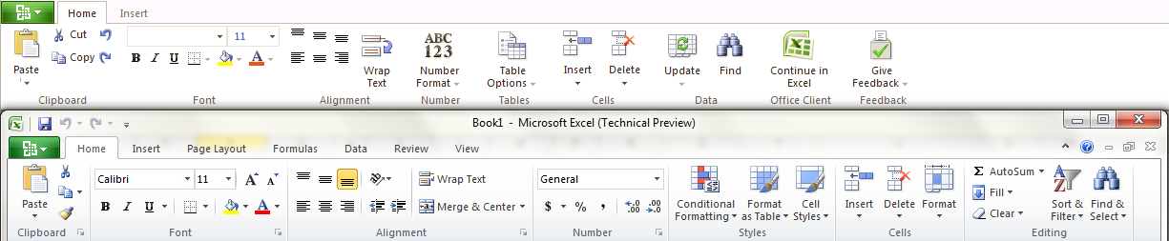
Office Web Applications
Ribbon comparison: Excel.

Slide 36
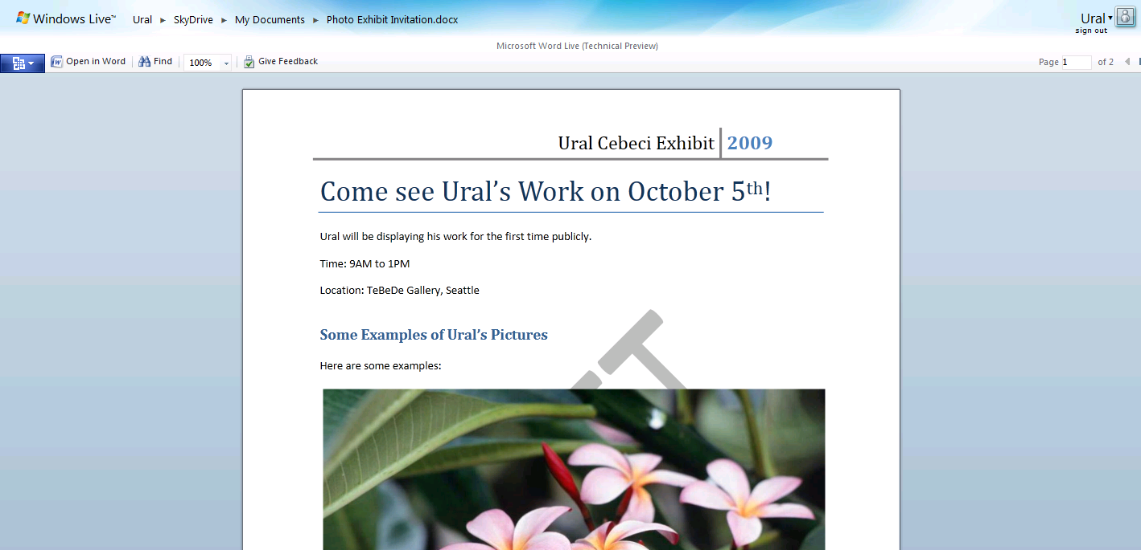
Word Web App

Slide 37
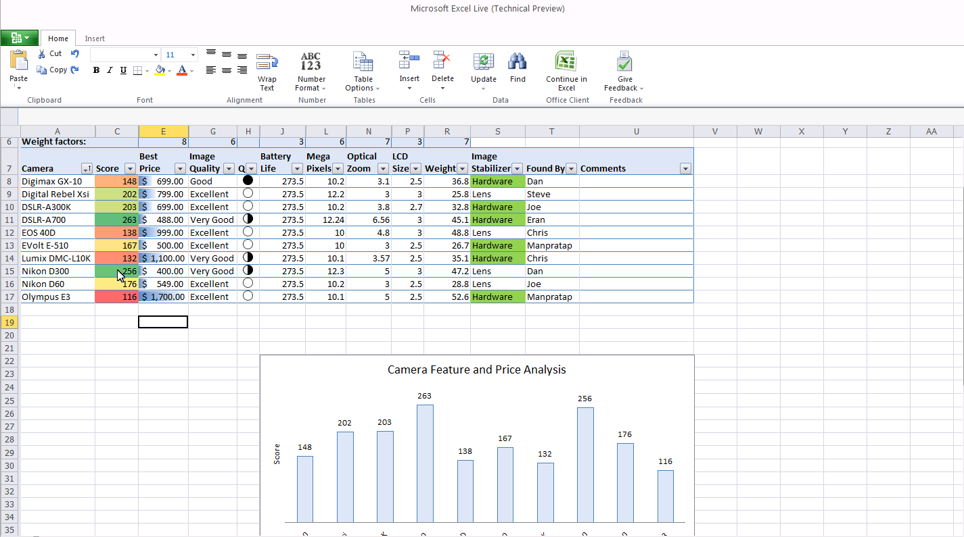
Excel Web App

Slide 38
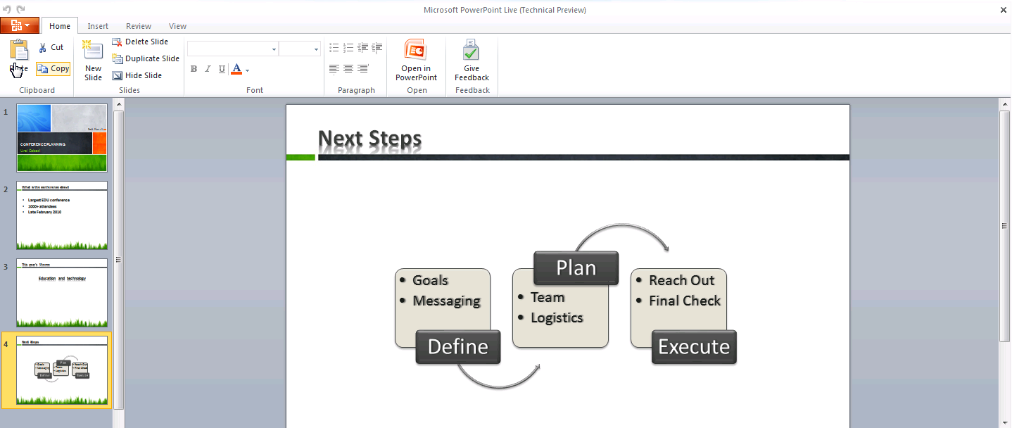
PowerPoint Web App

